Slide 1
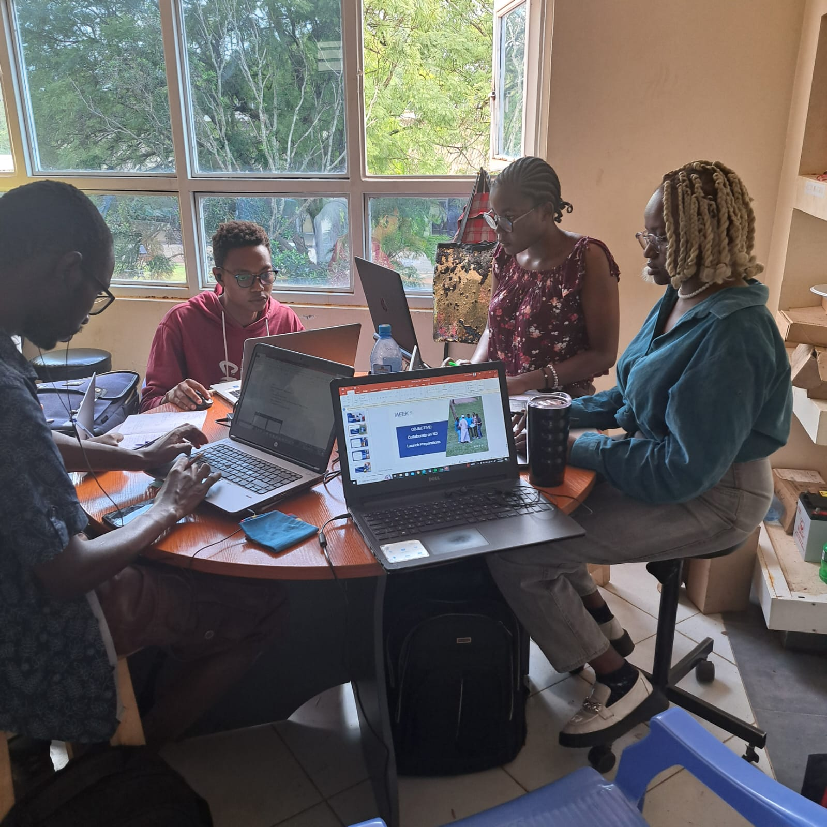

NAKUJA PROJECT

Slide 2

WEEK 1
OBJECTIVE:
Familiarize with N3.5

Slide 3
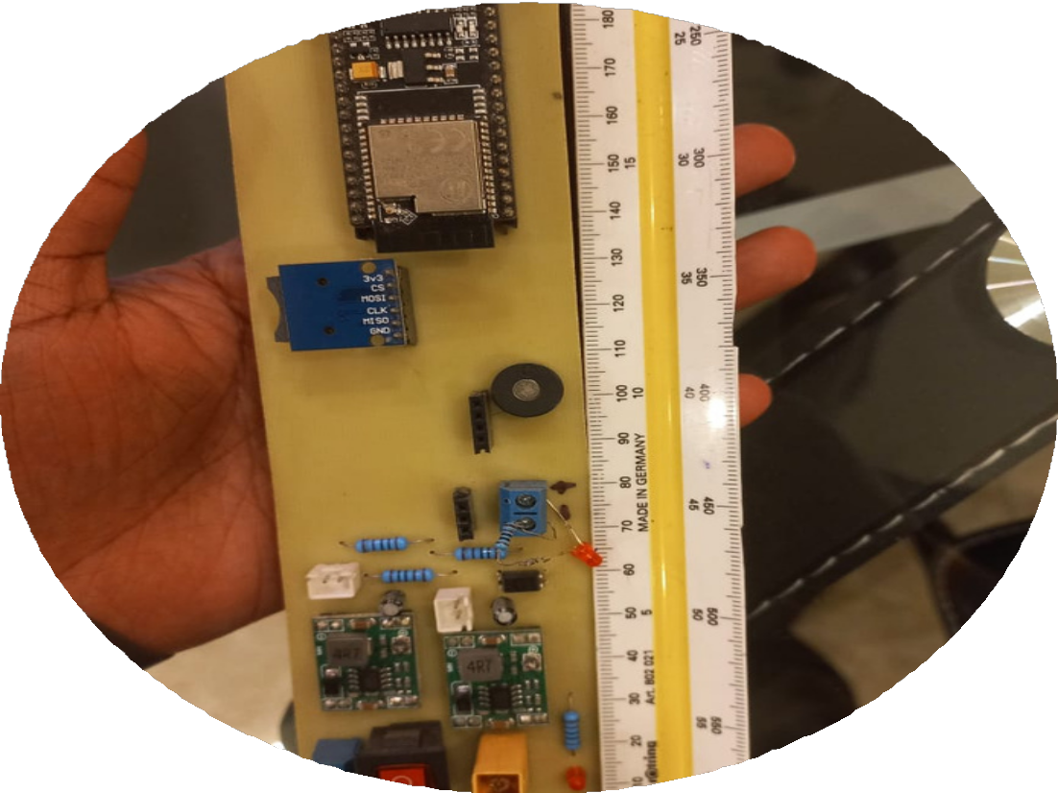
Week 1
Discussed and analysed the N3.5's rockets recovery avionics.
components on PCB:
Buck converters - voltage requirements
MCU ESP32 – antennae communication
BMP altimeter – Record altitude
GPS-Location
Buzzer-Signal on Status
Optocoupler-isolation electronic
raspberry pi

Slide 4


Week 1 Cont’
Familiarization of Github operations with Dr Aoki such as creation of a commit and pull request.
Orientation of N3.5 by batch 1 interns
Went through the SA cup requirements in terms of recovery. Some of the requirements missed by N3.5 was a dual deployment system and specified GPS modules
.

Slide 5
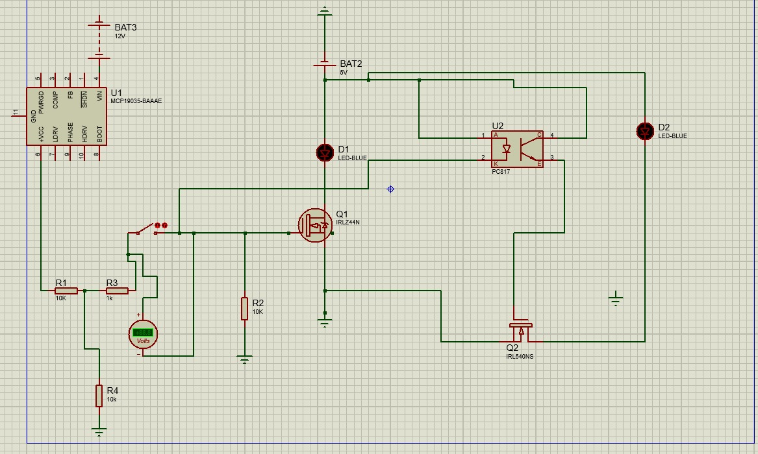
WEEK 2
OBJECTIVES
Find a non-pyro-technique method of ejection.
Design a flight computer circuit and ejection method circuit.

Slide 6
Week 2
Brainstorming and settling on a method of ejection. The use of a servomotor and spring mechanism was agreed upon. This mechanism also accommodates for the dual ejection mechanism as per the SA cup regulation.
Flight computer and ejection circuit was designed. Similar components as the N3.5 will be used on the PCB layout with additions involving the ejection circuit (optocoupler mosfet drivers, two servo motors)
Considered the use of a remote switch instead of an external switch to accommodate the Airframe team's request on the smoothness of the rocket.
Evaluated use of a microstrip patch antenna as it is more suitable for higher frequencies (4-8GHz). The design on how to place the antenna on the rocket was also considered.

Slide 7
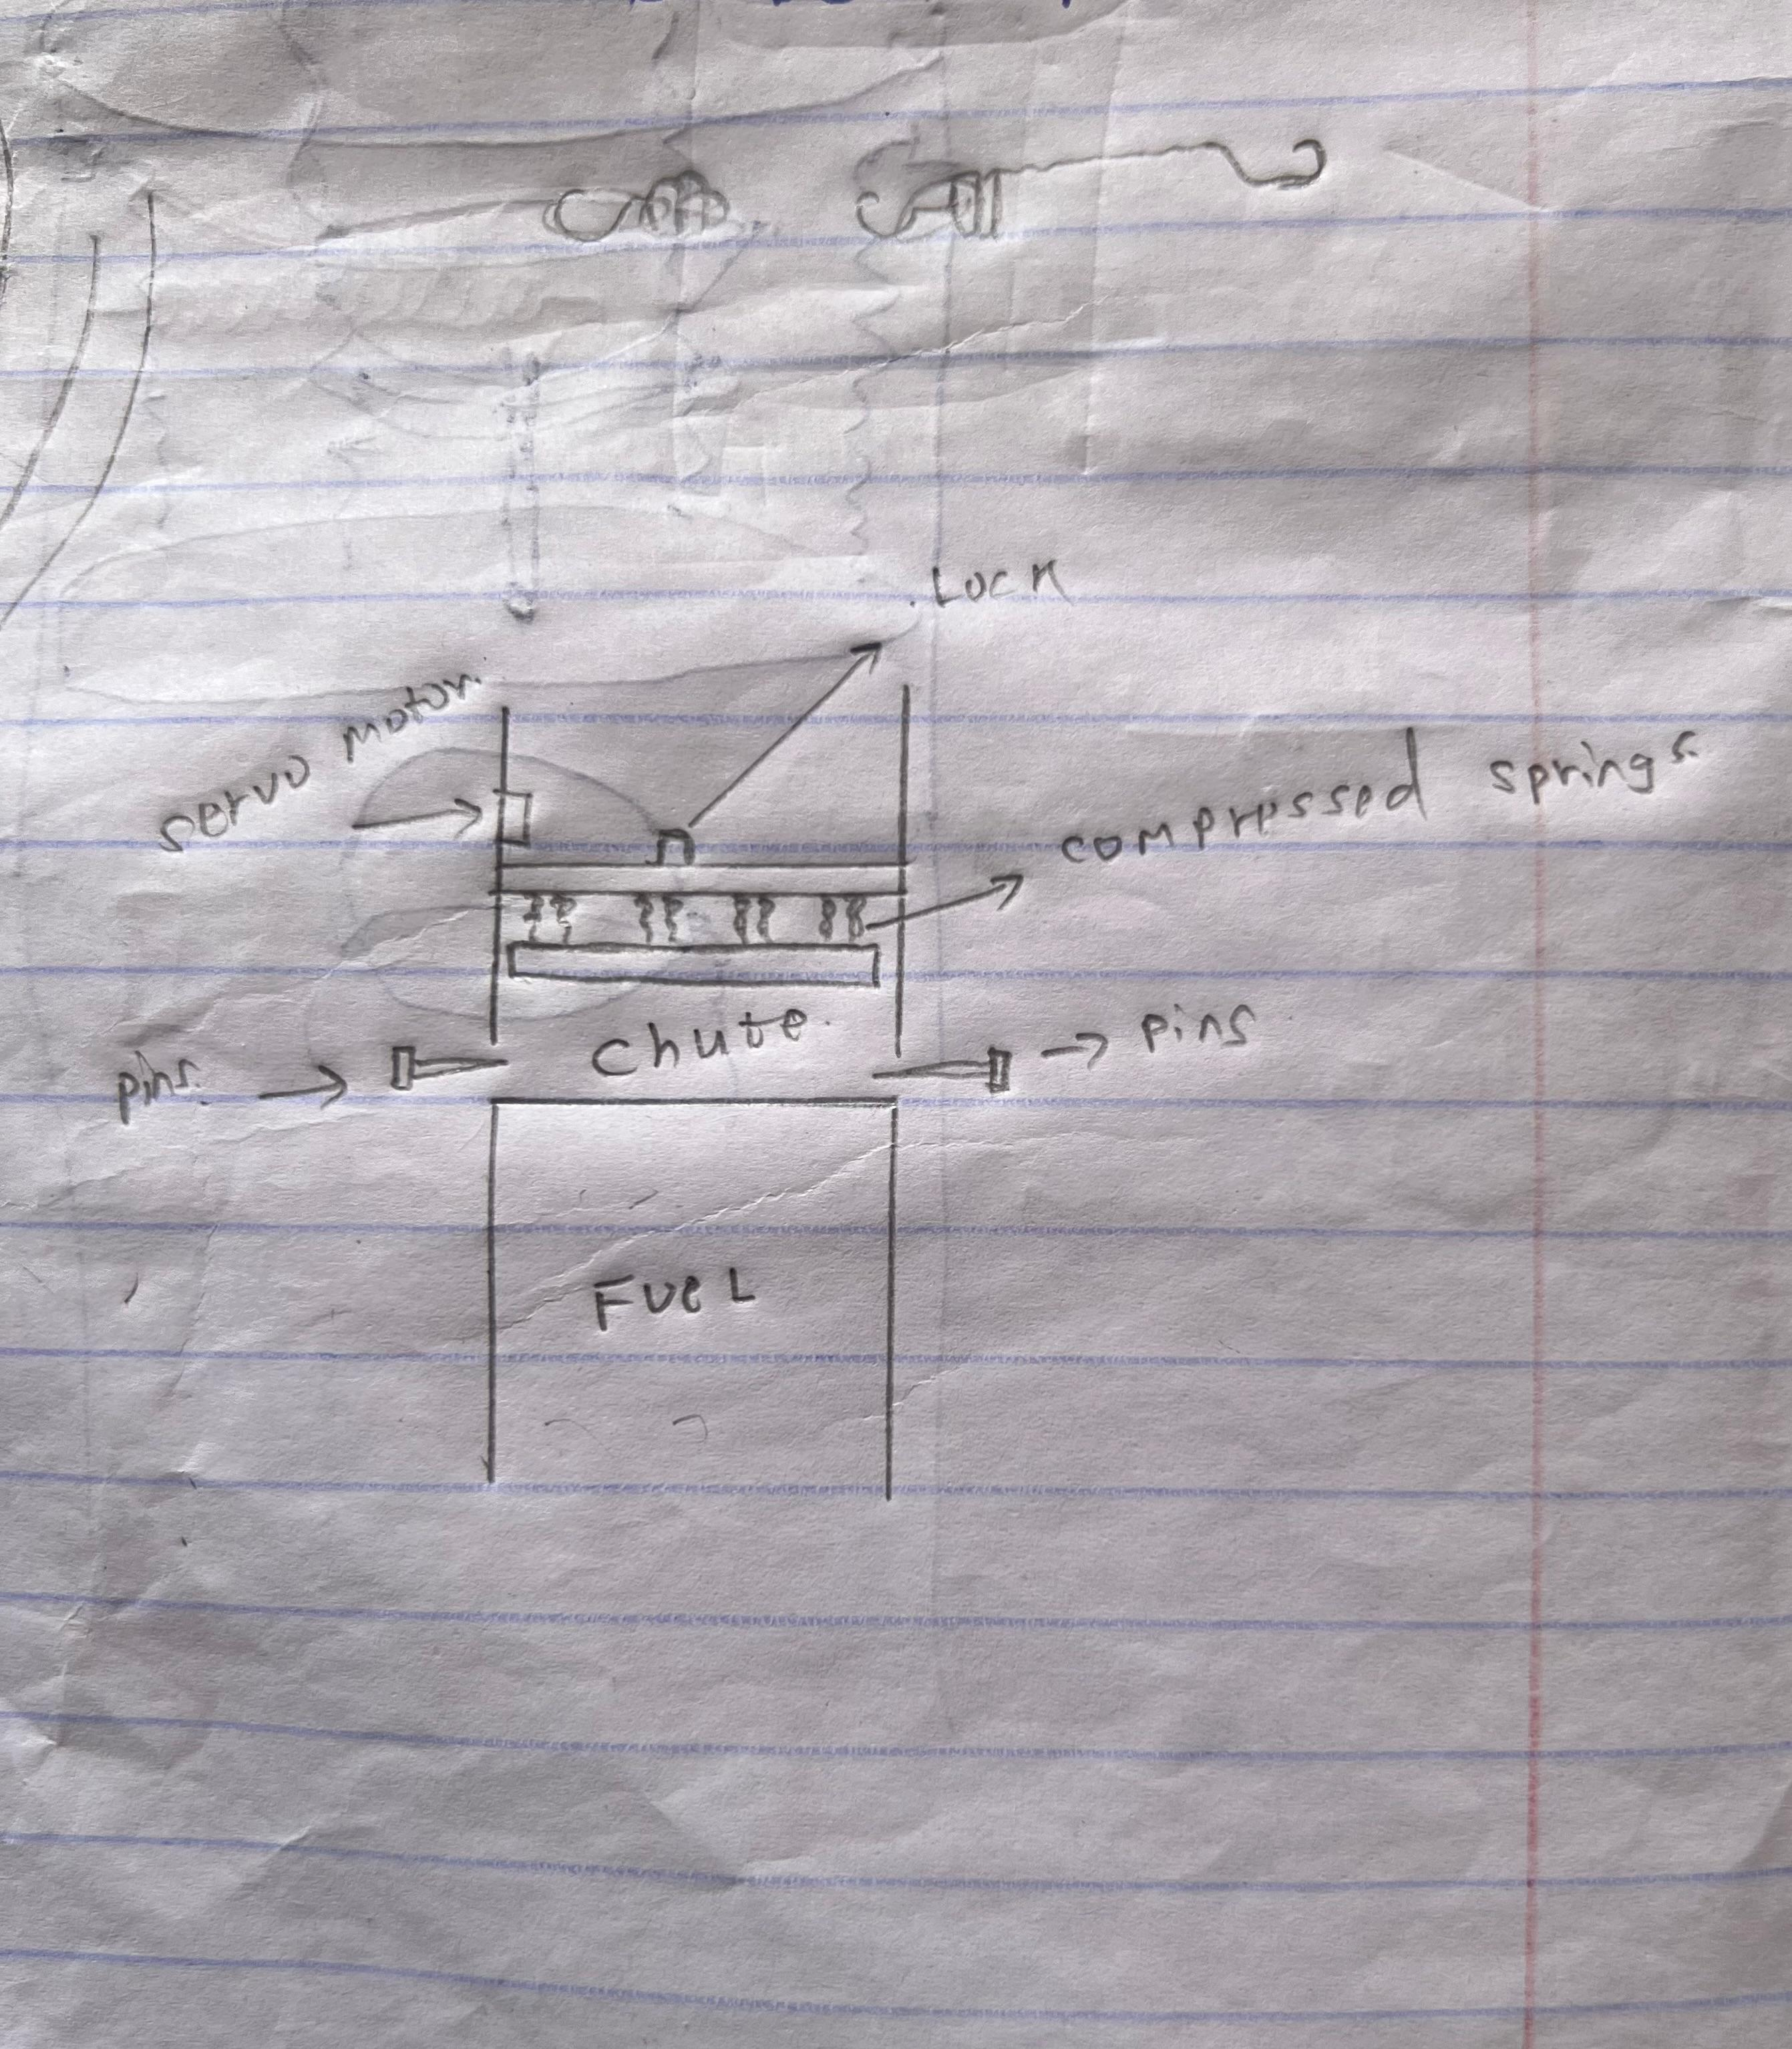
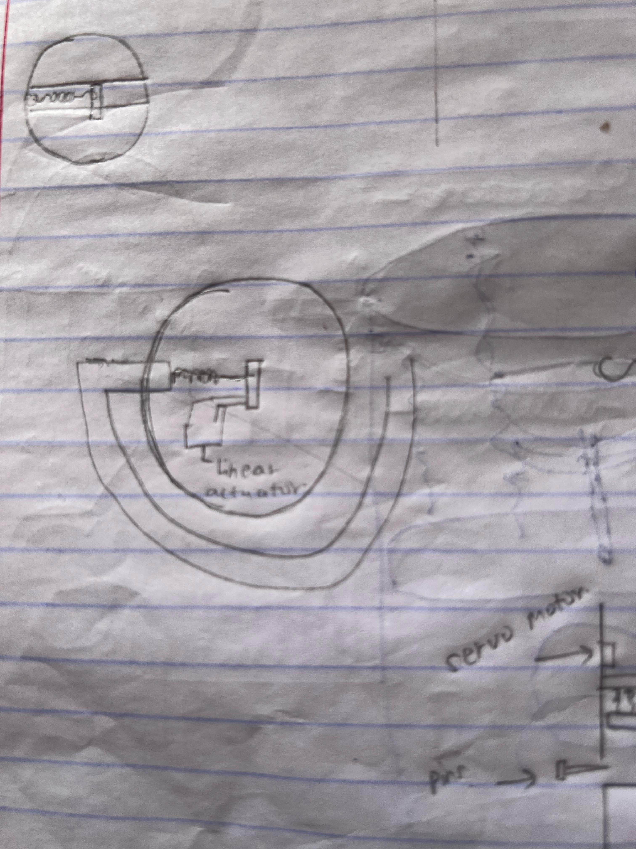
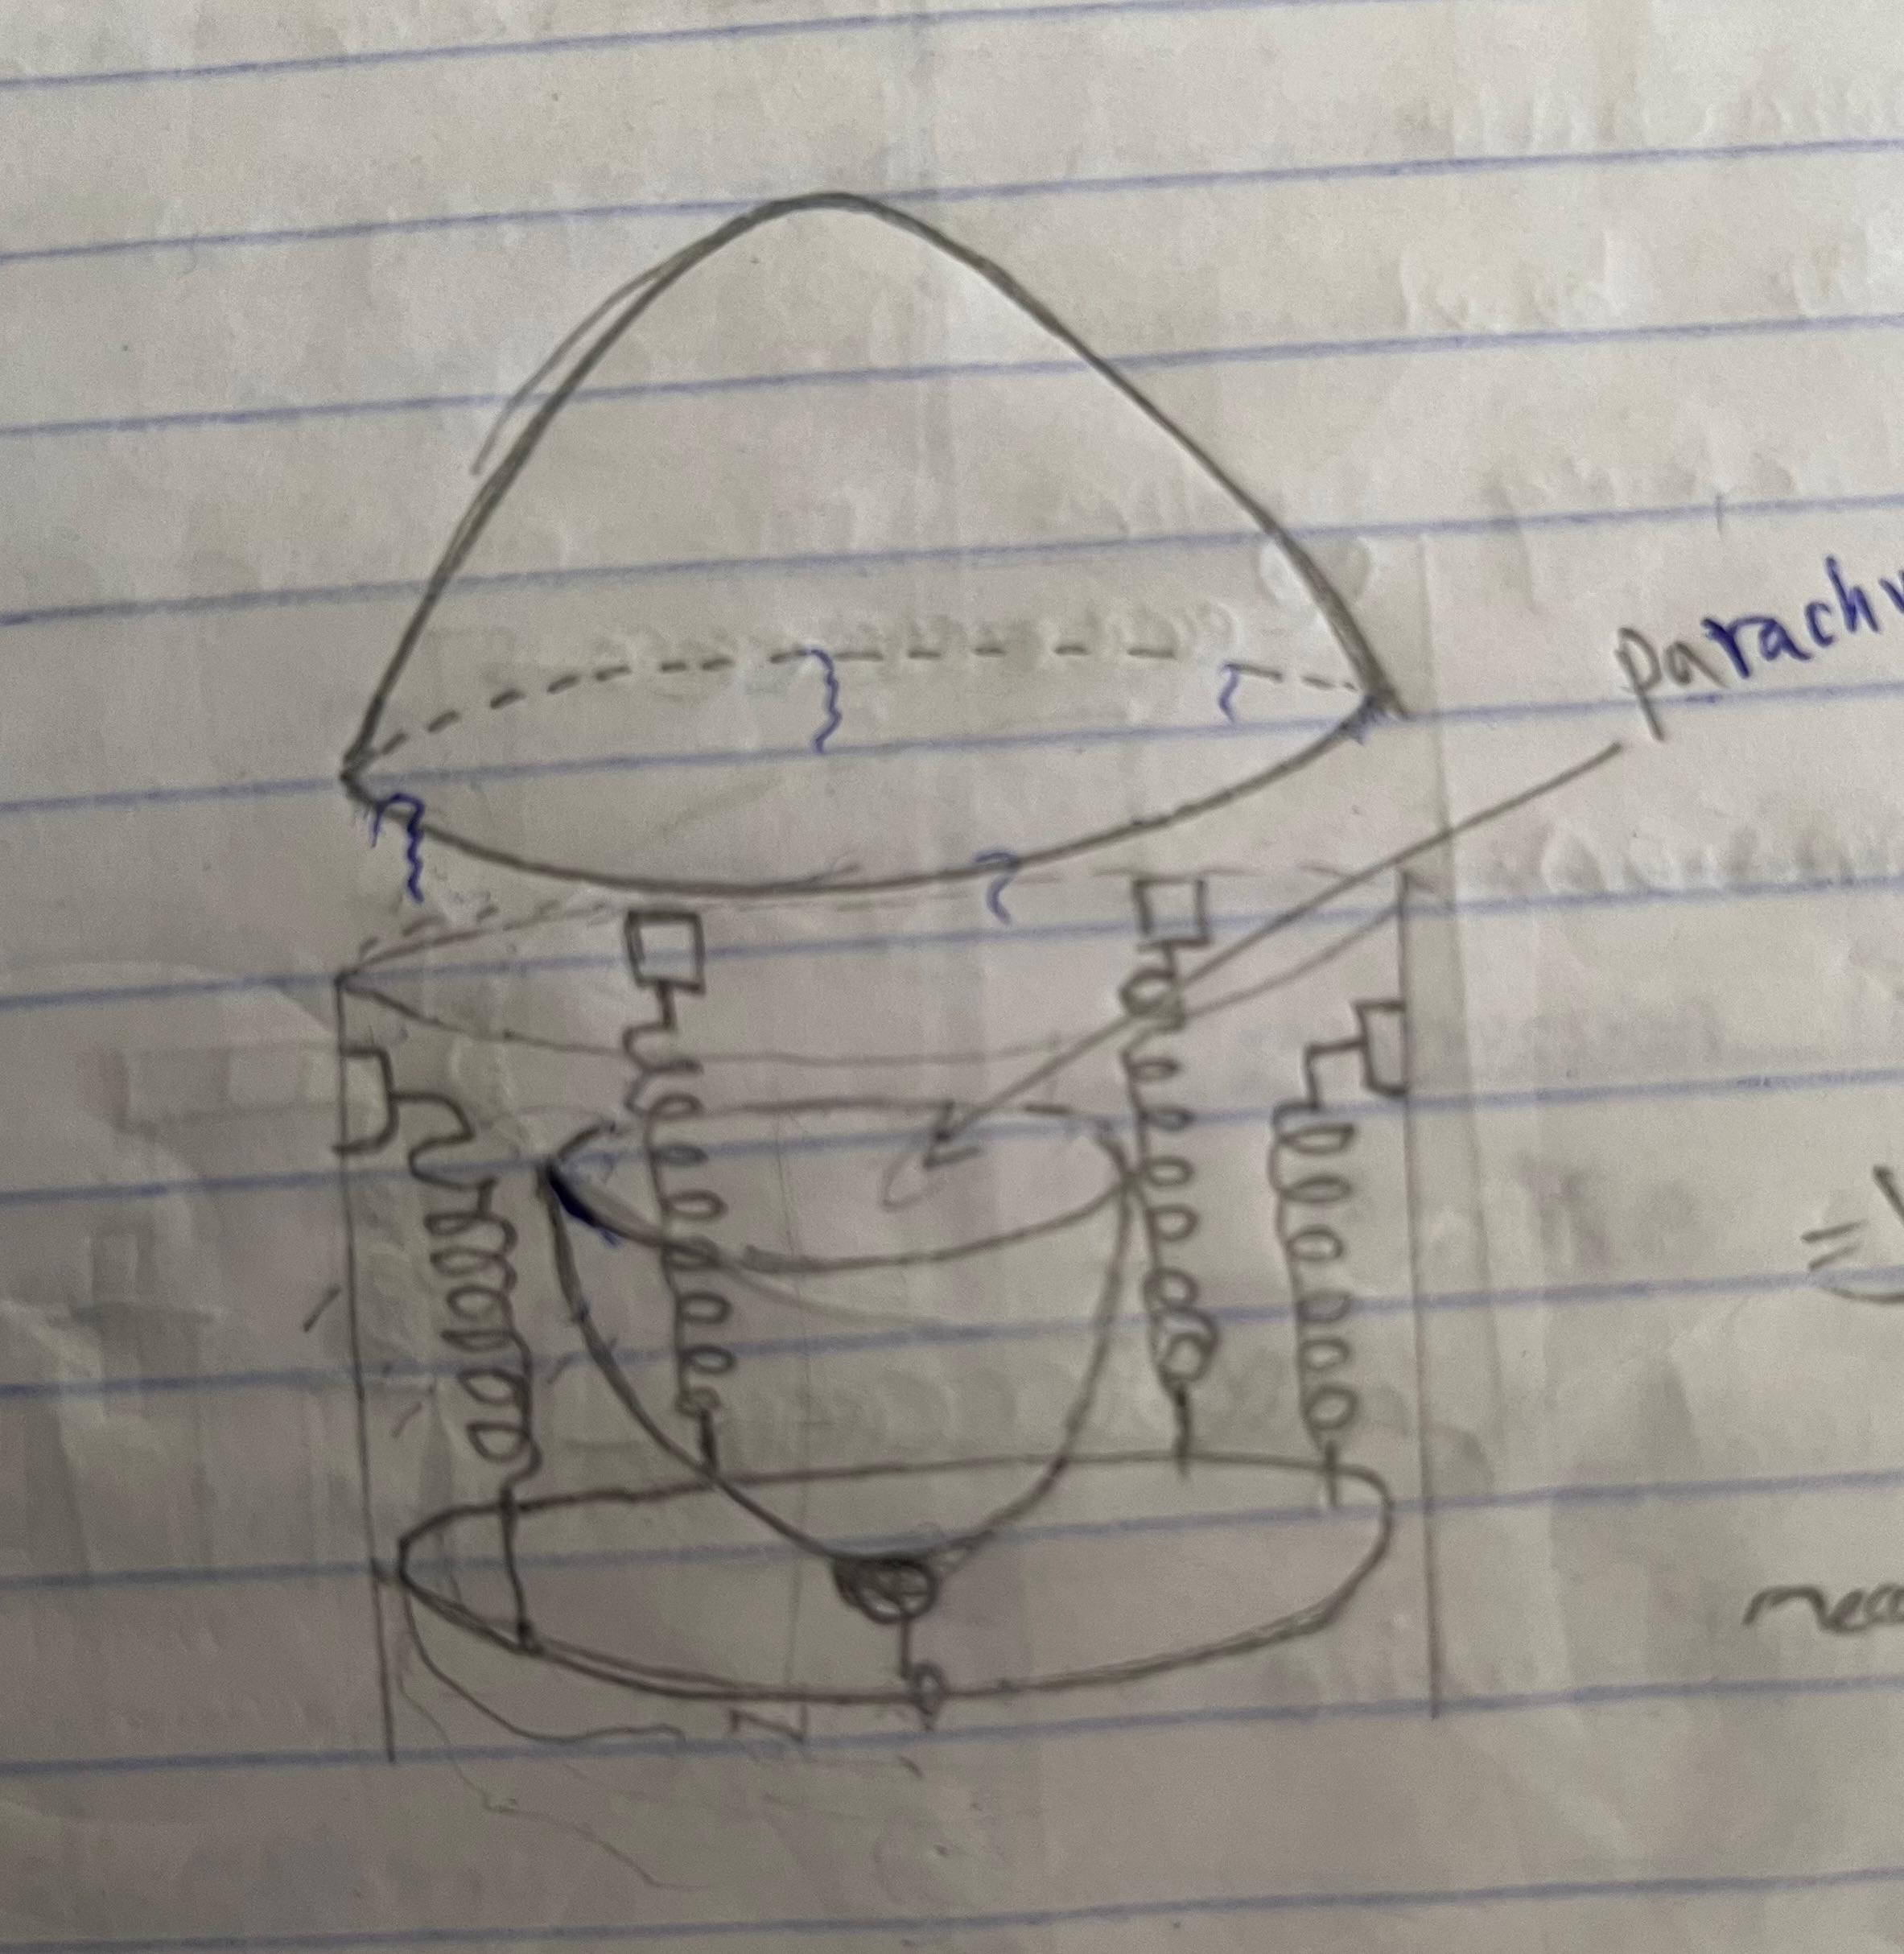
SKETCHING

Slide 8
Analysis of Challenges
EJECTION MECHANISM:
The motor might not provide sufficient torque to break the shear pins
GPS :
GPS are not readily available in the country..eg. Featherweight and Tele GPS
Flight computer design:
Two buck convertors are required one for 3V and another for 5V. Having a single buck convertor may overload it.
.

Slide 9
N4 Improvement Suggestions
Ejection mechanism:
Consider using either tension springs or compression springs.
GPS:
Explore alternative methods for determining apogee (e.g., real-time data analysis).Consider other models not given in the recommendations by the SA cup
Flight computer design:
Research on a suitable buck converter that will comfortably accommodate both voltages

Slide 10
THANK YOU

